Slide 1
AJAX
Course Code: CSC 3215
Course Title: Web Technologies
Dept. of Computer Science
Faculty of Science and Technology
Lecturer No: | 12 | Week No: | 12 | Semester:
Lecturer: | Md. Mustak Un Nobi ( mustak.nobi@aiub.edu )

Slide 2
Lecture Outline
Introduction to AJAX
AJAX Request and Response
Access JSON using AJAX

Slide 3
Introduction to AJAX
What is AJAX
AJAX = Asynchronous JavaScript And XML.
AJAX is not a programming language.
AJAX is a technique for accessing web servers from a web page.
A browser built-in XMLHttpRequest object to request data from a web server
Read data from a web server - after the page has loaded
Update a web page without reloading the page
Send data to a web server - in the background
JavaScript and HTML DOM to display or use the data

Slide 4
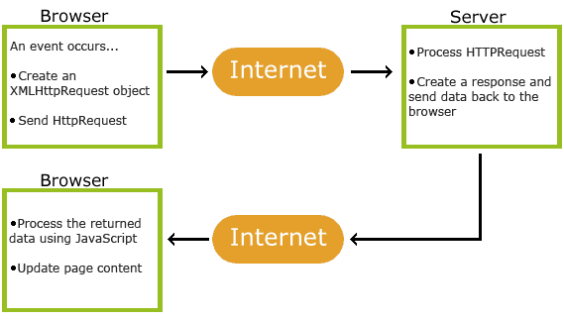
How AJAX Works
1. An event occurs in a web page when the page is loaded, a button is clicked
2. An XMLHttpRequest object is created by JavaScript
3. The XMLHttpRequest object sends a request to a web server
4. The server processes the request
5. The server sends a response back to the web page
6. The response is read by JavaScript
7. Proper action like page update is performed by JavaScript

Slide 5
Example
function loadDoc() { var xhttp = new XMLHttpRequest(); xhttp.onreadystatechange = function() { if (this.readyState == 4 && this.status == 200) { document.getElementById("demo").innerHTML = this.responseText; } }; xhttp.open("GET", "ajax_info.txt", true); xhttp.send(); }

Slide 6
The XMLHttpRequest Object
The keystone of AJAX is the XMLHttpRequest object.
The XMLHttpRequest object can be used to exchange data with a web server behind the scenes.
it is possible to update parts of a web page, without reloading the whole page.
Syntax for creating an XMLHttpRequest object:
[Variable] = new XMLHttpRequest();
var xhttp = new XMLHttpRequest();

Slide 7
XMLHttpRequest Object Methods
Method | Description
new XMLHttpRequest() | Creates a new XMLHttpRequest object
abort() | Cancels the current request
getAllResponseHeaders() | Returns header information
getResponseHeader() | Returns specific header information
open(method, url, async, user, psw) | Specifies the request method: the request type GET or POST url: the file location async: true (asynchronous) or false (synchronous) user: optional user name psw: optional password
send() | Sends the request to the server Used for GET requests
send(string) | Sends the request to the server. Used for POST requests
setRequestHeader() | Adds a label/value pair to the header to be sent

Slide 8
XMLHttpRequest Object Properties
Property | Description
onreadystatechange | Defines a function to be called when the readyState property changes
readyState | Holds the status of the XMLHttpRequest. 0: request not initialized 1: server connection established 2: request received 3: processing request 4: request finished and response is ready
responseText | Returns the response data as a string
responseXML | Returns the response data as XML data
status | Returns the status-number of a request 200: "OK" 403: "Forbidden" 404: "Not Found" For a complete list go to the Http Messages Reference
statusText | Returns the status-text (e.g. "OK" or "Not Found")

Slide 9
AJAX Request
To send a request to a server, open() and send() methods of the XMLHttpRequest object
xhttp.open("GET", "ajax_info.txt", true);
xhttp.send();
Method | Description
open(method, url, async) | Specifies the type of request method: the type of request: GET or POST url: the server (file) location async: true (asynchronous) or false (synchronous)
send() | Sends the request to the server (used for GET)
send(string) | Sends the request to the server (used for POST)

Slide 10
GET Requests
simple GET request:
xhttp.open("GET", "demo_get.php", true);
xhttp.send();
To get some specific data using GET method, need to use below example
Example 1:
xhttp.open("GET", "demo_get.php?t=" + Math.random(), true);
xhttp.send();
Example 2:
xhttp.open("GET", "demo_get2.php?fname=Henry&lname=Ford", true); xhttp.send();

Slide 11
POST Requests
simple POST request
xhttp.open("POST", "demo_post.php ", true);
xhttp.send();
To POST data like an HTML form, add an HTTP header with setRequestHeader().
To get specific data using POST method need to use
xhttp.open("POST", " demo_post.php", true); xhttp.setRequestHeader("Content-type", "application/x-www-form-urlencoded"); xhttp.send("fname=Henry&lname=Ford");
Method | Description
setRequestHeader(header, value) | Adds HTTP headers to the request header: specifies the header name value: specifies the header value

Slide 12
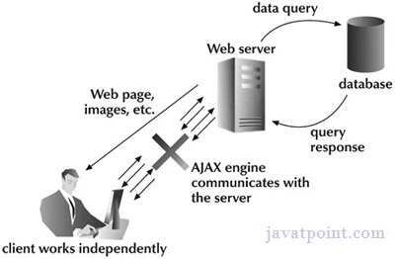
Asynchronous Requests
Server requests should be sent asynchronously.The async parameter of the open() method should be set to true:
xhttp.open("GET", " demo_post.php", true);
By sending asynchronously, the JavaScript does not have to wait for the server response.
execute other scripts while waiting for server response
deal with the response after the response is ready

Slide 13
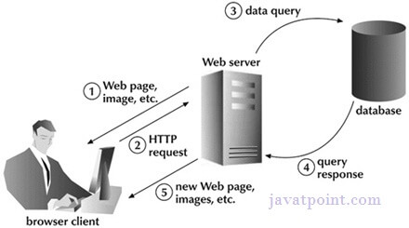
Synchronous Requests
A synchronous request blocks the client until operation completes i.e. browser is unresponsive.
To execute a synchronous request, change the third parameter in the open() method to false:
xhttp.open("GET", "ajax_info.txt", false);
Sometimes async = false are used for quick testing.

Slide 14
AJAX Response
The readyState property holds the status of the XMLHttpRequest.
The onreadystatechange property defines a function to be executed when the readyState changes.
The status property and the statusText property holds the status of the XMLHttpRequest object.
The onreadystatechange function is called every time the readyState changes.
When readyState is 4 and status is 200, the response is ready:
function loadDoc() { var xhttp = new XMLHttpRequest(); xhttp.onreadystatechange = function() { if (this.readyState == 4 && this.status == 200) { document.getElementById("demo").innerHTML = this.responseText; } }; xhttp.open("GET", "ajax_info.txt", true); xhttp.send(); }

Slide 15
AJAX Response
Server Response Methods
Method | Description
getResponseHeader() | Returns specific header information from the server resource
getAllResponseHeaders() | Returns all the header information from the server resource
Server Response Properties
Property | Description
responseText | get the response data as a JS string
responseXML | get the response data as XML Object

Slide 17
JSON
A JSON file is a file that stores simple data structures and objects in JavaScript Object Notation (JSON) format, which is a standard data interchange format.
It is primarily used for transmitting data between a web application and a server. JSON files are lightweight, text-based, human-readable, and can be edited using a text editor.

Slide 18
JSON vs XML
Similarities:
Both JSON and XML are "self describing" (human readable)
Both JSON and XML are hierarchical (values within values)
Both JSON and XML can be parsed and used by lots of programming languages
Both JSON and XML can be fetched with an XMLHttpRequest
Differences:
JSON doesn't use end tag
JSON is shorter
JSON is quicker to read and write
JSON can use arrays

Slide 19
JSON Example (employee.json)
{"employees":[ { "firstName":"John", "lastName":"Doe" }, { "firstName":"Anna", "lastName":"Smith" }, { "firstName":"Peter", "lastName":"Jones" } ]}
XML Example (employee.xml)
<employees>
<employee> <firstName>John</firstName> <lastName>Doe</lastName> </employee> <employee> <firstName>Anna</firstName> <lastName>Smith</lastName> </employee> <employee> <firstName>Peter</firstName> <lastName>Jones</lastName> </employee> </employees>

Slide 20
JSON Data Types
a string { "name":"John" }
a number { "age":30 }
an object (JSON object)
{ "employee":{ "name":"John", "age":30, "city":"New York" } }
an array { "employees":[ "John", "Anna", "Peter" ] }
a Boolean { "sale":true }
Null { "middlename":null }

Slide 21
PHP JSON Functions
json_encode() - The json_encode() function is used to encode a value to JSON format.
json_decode() - The json_decode() function is used to decode or convert a JSON object to a PHP object.
file_put_contents() - The file_put_contents() writes data to a file.
file_get_contents() - The file_get_contents() reads a file into a string.

Slide 22
AJAX And JSON
Create an HTML file (e.g., index.html) and include the necessary HTML structure.
<!DOCTYPE html>
<html lang="en">
<head>
<meta charset="UTF-8">
<meta name="viewport" content="width=device-width, initial-scale=1.0">
<title>AJAX Tutorial</title>
</head>
<body>
<div id="content">
<!-- Content will be loaded here -->
</div>
<button id="loadData">Load Data</button>
</body>
</html>

Slide 23
AJAX And JSON
Create a JavaScript file (e.g., script.js) and write the AJAX code to fetch data from a server.
document.getElementById('loadData').addEventListener('click', function() {
var xhr = new XMLHttpRequest();
xhr.open('GET', 'data.json', true);
xhr.onload = function() {
if (xhr.status >= 200 && xhr.status < 300) {
var data = JSON.parse(xhr.responseText);
document.getElementById('content').innerHTML = data.message;
} else {
console.error('Request failed with status ' + xhr.status);
}
};
xhr.onerror = function() {
console.error('Request failed');
};
xhr.send();
});

Slide 24
AJAX And JSON
Create a JSON file (e.g., data.json) with some sample data.
{
"message": "Hello, AJAX!"
}

Slide 25
AJAX And JSON
To fetch MySQL data using PHP and return it as JSON, you can follow these steps:
Connect to the MySQL database.
Execute a query to fetch the desired data.
Fetch the data and convert it into a PHP associative array.
Encode the PHP array into JSON format.
Output the JSON data.

Slide 26
AJAX And JSON
<?php
// Database connection parameters
$servername = "localhost";
$username = "username";
$password = "password";
$database = "database_name";
// Create connection
$conn = new mysqli($servername, $username, $password, $database);
// Check connection
if ($conn->connect_error) {
die("Connection failed: " . $conn->connect_error);
}
// SQL query to fetch data
$sql = "SELECT * FROM your_table";
$result = $conn->query($sql);
if ($result->num_rows > 0) {
// Initialize an array to store the data
$data = array();
// Fetch data from each row
while ($row = $result->fetch_assoc()) {
// Add each row to the data array
$data[] = $row;
}
// Convert data array to JSON format
$json_data = json_encode($data);
echo $json_data;
} else {
// No data found
echo "No data found";
}
// Close connection
$conn->close();
?>

Slide 27
AJAX And JSON
<!DOCTYPE html>
<html lang="en">
<head>
<title>Fetch Data with AJAX</title>
</head>
<body>
<h1>Fetch Data from Database</h1>
<div id="data-container"></div>
<script>
// Function to fetch data using AJAX
document.addEventListener('DOMContentLoaded', function() {
var xhr = new XMLHttpRequest();
xhr.open('GET', 'fetch_data.php', true);
xhr.onreadystatechange = function() {
if(this.readyState==4 && this.status== 200) {
var data = JSON.parse(xhr.responseText);
var html = '<table border="1"><tr><th>ID</th><th>Name</th><th>Email</th></tr>';
data.forEach(function(item) {
html += '<tr>';
html += '<td>' + item.id + '</td>';
html += '<td>' + item.name + '</td>';
html += '<td>' + item.email + '</td>';
html += '</tr>';
});
html += '</table>';
document.getElementById('data-container').innerHTML = html;
} else {
console.error('Request failed with status ' + xhr.status);
}
};
xhr.onerror = function() {
console.error('Request failed');
};
xhr.send();
});
</script>
</body>
</html>

Slide 28
References
MySQL - www.mysql.com
W3Schools Online Web Tutorials- www.w3schools.com
PHP Manual - www.php.net
Free Online Tutorials - www.javatpoint.com

Slide 29
Books
Sams Teach Yourself Ajax JavaScript and PHP All in One; Phil Ballard and Michael Moncur;
Sams Publishing; 2010
JavaScript Phrasebook; Christian Wenz; Sams Publishing; 2007
PHP and MySQL Web Development, 4/E; Luke Welling and Laura Thomson; AddisonWesley Professional; 2009
JavaScript for Programmers Paul J. Deitel and Harvey M. Deitel; Prentice Hall; 2009

